Slide 1
Integrated Project Plan
Muhammad Fahad Bashir

Slide 2
What Is an Integrated Project Plan?
An Integrated Project Plan brings together all key planning elements:
Scope (what we will do)
Schedule (when we’ll do it)
Resources (who will do it)
Tools & Risk (how we track & manage it)

Slide 3
Why Important
Benefit | Explanation
Centralized view | Combines planning into a single roadmap
Team alignment | Everyone knows who’s doing what and when
Helps QA & PM | Tracks dependencies between dev, testing, design
JIRA compatible | Each story/task is mapped with owner & timeline

Slide 4
Tools to Build It
Tool | Use
Google Sheets / Excel | Planning table, resource chart
JIRA Roadmaps | View project flow with Epics/Stories/Sprints
ClickUp / Notion | Drag-drop Gantt charts
draw.io | Visual WBS or dependencies

Slide 5
Activity Plan
Step | Task | Tool | Output
1 | Review scope (quiz app) | Word / Google Docs | Finalized scope doc
2 | Review WBS | draw.io | Tree breakdown
3 | Finalize Gantt chart | Excel | Timeline for features
4 | Map resources | Assign team to each task | Table in Excel or ClickUp
5 | Open JIRA | Show Epics → Stories → Tasks | Sprint view
6 | Show Roadmap view | Timeline view of Epics | Visual project flow
Notes:
“With an integrated plan, we can now move confidently into execution. All tasks, timelines, and owners are defined — ensuring smooth delivery from start to finish.”

Slide 6
📅 Day | 🎯 Topic | 💡 What You Learned | 🔗 How It Was Applied (Food App Example)
Day 16 | Intro to PM & PMBOK Framework | Learned about the 5 Process Groups (Initiation → Planning → Execution → Monitoring → Closing) and 10 Knowledge Areas. Installed & explored JIRA and Hubstaff. | 🔧 Created JIRA project board for Food Delivery App. 🕒 Used Hubstaff (or demo) for tracking future time logs. 🗂 Understood how planning fits in PM lifecycle.
Day 17 | Stakeholder & Communication Management | Identified key stakeholders (users, restaurant admin, devs, PM). Built RACI matrix to define roles. Learned how communication and responsibilities are tracked. | 👥 Created a Stakeholder Map (User, Dev, QA, PM, Restaurant Owner) 📊 Built RACI table for who is Responsible, Accountable, Consulted, Informed. 📬 JIRA: Assigned issues/tasks to responsible persons.
Day 18 | Scope & Requirements Management / UML Design | Wrote the Scope Statement. Defined what's in & out. Created and tracked User Stories in JIRA. Introduced UML diagrams to visualize the system. | 📄 Scope included user login, browse menu, cart, order tracking. 🧾 Wrote 5–7 user stories in JIRA (e.g., browse restaurants, track delivery). 📊 Created UML diagrams: Use Case (User/Admin), Activity (Order Flow).
Day 19 | Scheduling & WBS | Created Work Breakdown Structure. Drew Gantt Chart. Understood Critical Path Method. Scheduled tasks in JIRA using timeline views. | 📌 WBS created with modules: User App, Admin Panel, API. 📅 Excel Gantt chart created with all task timelines. ⏳ Identified dependent tasks (e.g., UI before API). 🛠 Used JIRA to assign due dates to Epics/Stories.
Day 20 | Integrated Project Plan | Combined Scope + Schedule + Resources into one view. Saw how to align JIRA roadmap view with planned milestones. | 📋 Finalized Integrated Plan in Word: Included scope, timelines, team roles, and tasks. 🗺️ JIRA Roadmap visualized progress from planning to execution. ✅ Plan became a baseline for tracking the entire project.

Slide 7
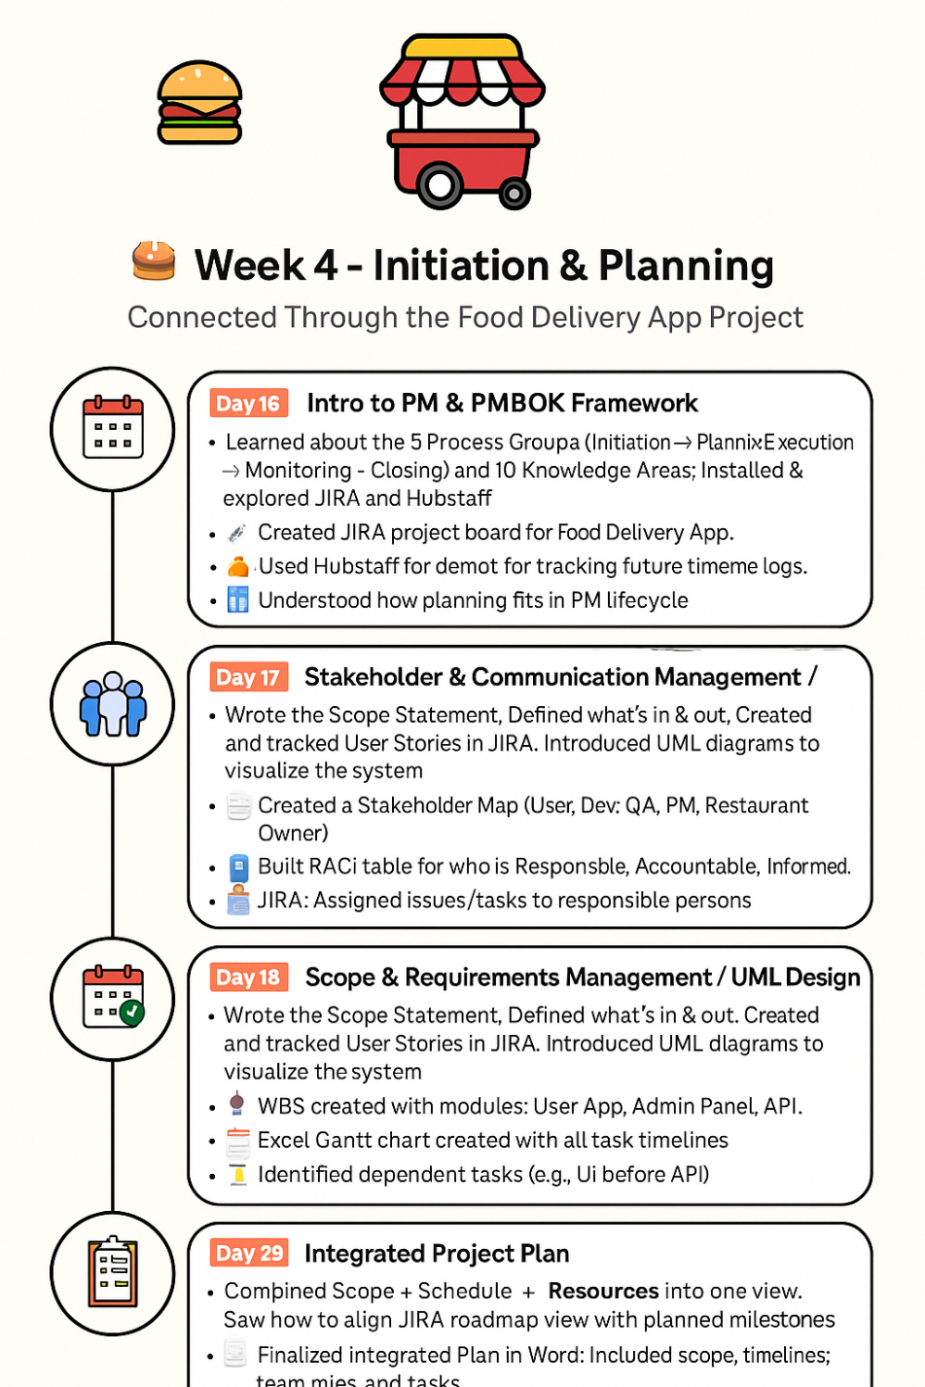
Week 4 Recap
How a realistic food delivery app can demonstrate professional project planning — including everything from PMBOK alignment to user stories, timelines, stakeholder roles, and roadmap tracking using JIRA and Hubstaff.

Slide 8
Resource & Cost Management

Slide 9
Resource Management
Resource Management is about assigning the right people to the right tasks at the right time.
Type of Resources | Examples
Human | Developer, QA, PM, Designer
💻 Tools | JIRA, Selenium, Postman
💾 Infrastructure | Hosting, servers, devices

Slide 10
What is Cost Management?
Cost Management is the process of planning, estimating, budgeting, and controlling project costs.
Phase | Description
💰 Estimating | Predicting how much each resource will cost
Budgeting | Allocating money across all phases/features
📉 Cost Control | Monitoring if the project stays within budget

Slide 11
🔷 Effort Estimation Techniques
Technique | Description
Expert Judgment | Ask experienced devs for time estimates
Story Points | Agile method to measure task complexity
Three-Point Estimate | (Best + Worst + Expected) / 3
T-Shirt Sizing | XS–XL size to group similar efforts

Slide 12
Activity
Step | Activity | Tool | Output
1️⃣ | Assign tasks to team in JIRA (e.g., “Build UI”, “Write API”) | JIRA | Team member assignments
2️⃣ | Add estimates to each task (e.g., 2h, 5h) | JIRA | Time tracking baseline
3️⃣ | Use Hubstaff (or demo) to log real work time | Hubstaff | Daily time report
4️⃣ | Compare estimated vs actual time | JIRA + Hubstaff | Identify overruns or underestimates
5️⃣ | Create a simple cost table (e.g., hourly rate × time) | Excel / Notion | Budget overview

Slide 13
Example Resource & Cost Table (Food Delivery App)
Task | Assigned To | Estimated Time | Rate/hr | Cost
UI Design | Fatima | 6 hrs | $15 | $90
API Dev | Ali | 10 hrs | $20 | $200
Testing | Ayesha | 8 hrs | $18 | $144
Total | — | — | — | $434

